Slide 1
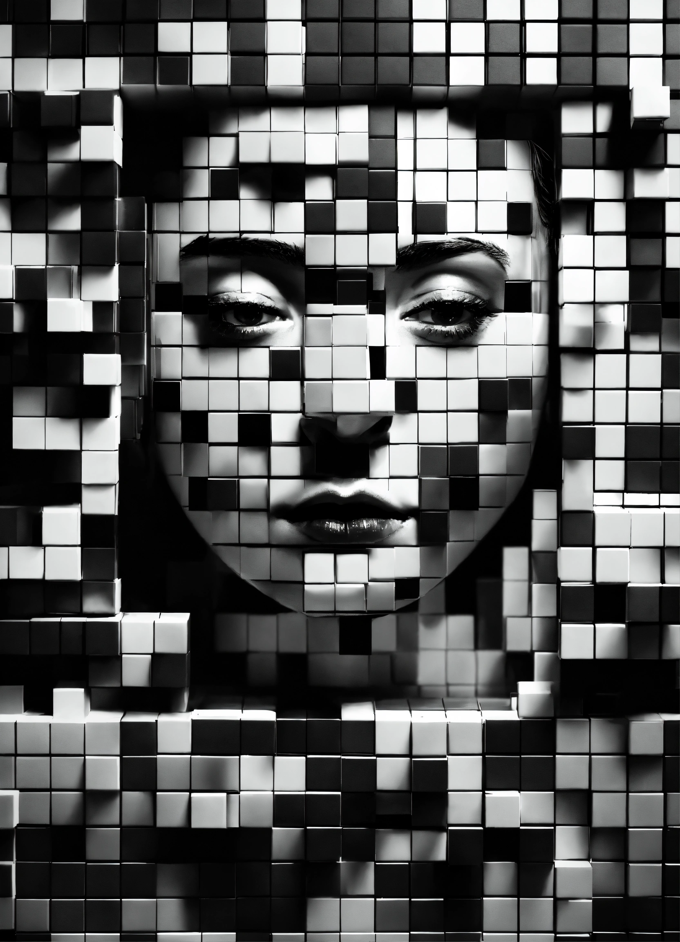
“Handcrafting Pixels: Adventure into the Convolutional Layers of Image Recognition”

Slide 2
0 | 0 | 0 | 1 | 1 | 0 | 0 | 0
0 | 0 | 0 | 1 | 1 | 0 | 0 | 0
0 | 0 | 0 | 1 | 1 | 0 | 0 | 0
1 | 1 | 1 | 1 | 1 | 1 | 1 | 1
1 | 1 | 1 | 1 | 1 | 1 | 1 | 1
0 | 0 | 0 | 1 | 1 | 0 | 0 | 0
0 | 0 | 0 | 1 | 1 | 0 | 0 | 0
0 | 0 | 0 | 1 | 1 | 0 | 0 | 0
“Cross” image
By simulating the application of filters to images manually and gaining a conceptual understanding of the feature detection process in CNNs using an 8x8 or 5x5 grid, you can deepen your comprehension of convolutional layers and filters in image recognition.

Slide 3





Horizontal Edge Filter
-1 | 0 | 1
-1 | 0 | 1
-1 | 0 | 1
-1 | -1 | -1
0 | 0 | 0
1 | 1 | 1
Vertical Edge Filter
After designing and applying filters to the image grid, you will observe how different filters detect features like vertical or horizontal edges. This hands-on approach helps you understand how convolutional layers in CNNs extract meaningful information from images by convolving filters across them.

Slide 4
Convolution
0 | 0 | 0 | 1 | 1 | 0 | 0 | 0
0 | 0 | 0 | 1 | 1 | 0 | 0 | 0
0 | 0 | 0 | 1 | 1 | 0 | 0 | 0
1 | 1 | 1 | 1 | 1 | 1 | 1 | 1
1 | 1 | 1 | 1 | 1 | 1 | 1 | 1
0 | 0 | 0 | 1 | 1 | 0 | 0 | 0
0 | 0 | 0 | 1 | 1 | 0 | 0 | 0
0 | 0 | 0 | 1 | 1 | 0 | 0 | 0
-1 | 0 | 1
-1 | 0 | 1
-1 | 0 | 1
Vertical edge filter calculates as it slides every 3x3 section

Slide 5
After using the vertical filter, The left side top and bottom is the strongest and fades as it goes towards the middle. Meaning the filter detected a line close to that area
-1 x 0 + -1 x 0 + -1 x 0
-1 x 0 + -1 x 0 + -1 x 0
-1 x 0 + -1 x 0 + -1 x 0 = 0
-1 | 0 | 1
-1 | 0 | 1
-1 | 0 | 1
Output image
0 | 0 | 0 | 1 | 1 | 0 | 0 | 0
0 | 0 | 0 | 1 | 1 | 0 | 0 | 0
0 | 0 | 0 | 1 | 1 | 0 | 0 | 0
1 | 1 | 1 | 1 | 1 | 1 | 1 | 1
1 | 1 | 1 | 1 | 1 | 1 | 1 | 1
0 | 0 | 0 | 1 | 1 | 0 | 0 | 0
0 | 0 | 0 | 1 | 1 | 0 | 0 | 0
0 | 0 | 0 | 1 | 1 | 0 | 0 | 0
0 | 3 | 3 | -3 | -3 | 0
0 | 2 | 2 | -2 | -2 | 0
0 | 1 | 1 | -1 | -1 | 0
0 | 1 | 1 | -1 | -1 | 0
0 | 2 | 2 | -2 | -2 | 0
0 | 3 | 3 | -3 | -3 | 0

Slide 6

What Is the Point
By simulating the application of filters to images by hand, individuals can gain a deeper understanding of the role of convolutional layers and filters in image recognition. This hands-on approach allows them to observe firsthand how filters detect features such as edges, corners, and patterns within an image. Through this process, individuals can comprehend how convolutional layers analyze and extract important features from images, which is crucial in the functioning of Convolutional Neural Networks (CNNs) for tasks like image recognition. This practical exercise enhances their conceptual understanding of how CNNs process visual data and make decisions based on detected features.

Slide 7
References
Lehn, Frederik Vom. “Understanding the Convolutional Filter Operation in CNN’s | Advanced Deep Learning.” Medium, 25 Dec. 2023, medium.com/advanced-deep-learning/cnn-operation-with-2-kernels-resulting-in-2-feature-mapsunderstanding-the-convolutional-filter-c4aad26cf32
Keita, Z. (2023, April 14). Python convolutional Neural Networks (CNN) with tensorflow tutorial. DataCamp. https://www.datacamp.com/tutorial/cnn-tensorflow-python

